Slide 1
ASP .NET Web API 2
01-May-18 | Start
Appendix
Online

Slide 2
Web API 2
Ch | Date
1 | ddmmmyy
2
3
4
5
6
7
8
Designing Evolvable Web APIs 03 2014 with ASP.NET

Slide 3
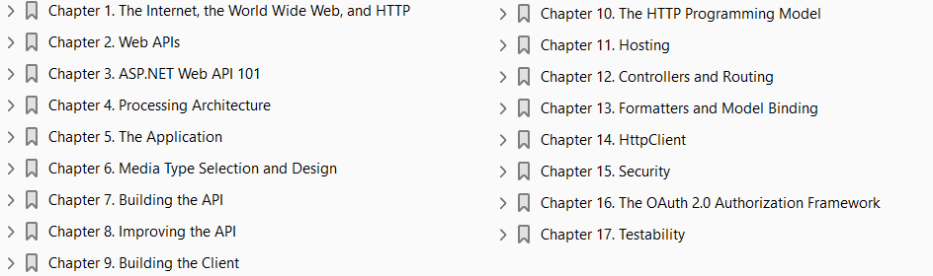

Slide 4

1
The Internet, the World Wide Web, and HTTP

Slide 5
Intro
We start our journey toward Web APIs at the beginning.
In the late 1960s the Advanced Research Projects Agency Network (ARPANET), a series of network-based systems connected by the TCP/IP protocol, was created by the Defense Advanced Research Projects Agency (DARPA).
Initially, it was designed for universities and research laboratories in the US to share data. (see Figure 1-1).
ARPANET continued to evolve and ultimately led in 1982 to the creation of a global set of interconnected networks known as the Internet.
The Internet was built on top of the Internet protocol suite (also known as TCP/IP), which is a collection of communication protocols.
Whereas ARPANET was a fairly closed system, the Internet was designed to be a globally open system connecting private and public agencies, organizations, individuals, and institutions.
In 1989, Tim Berners-Lee, a scientist at CERN, invented the World Wide Web, a new system for accessing linked documents via the Internet with a web browser.
Navigating the documents of the Web (which were predominantly written in HTML) required a special application protocol, the Hypertext Transfer Protocol (HTTP).
This protocol is at the center of what drives websites and Web APIs.

Slide 6
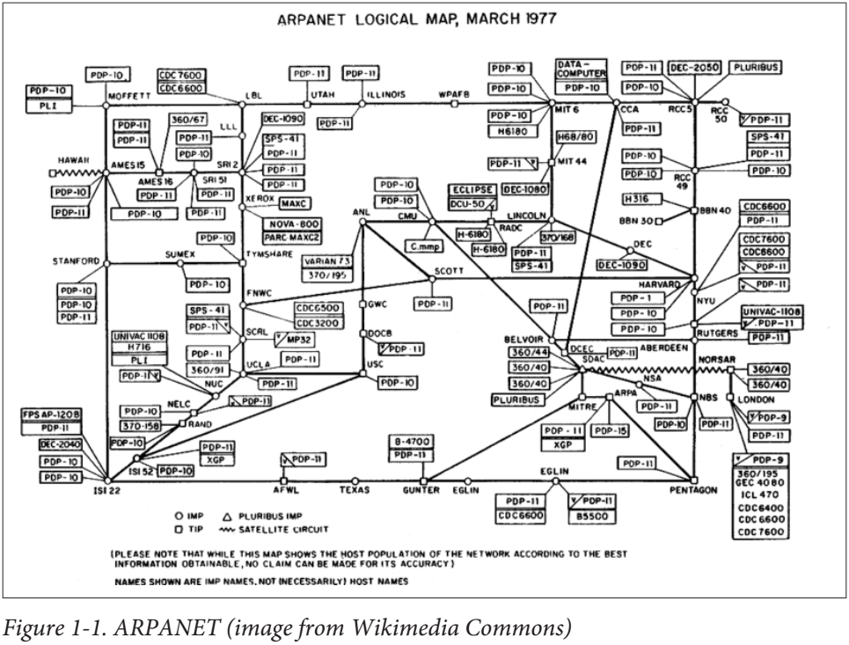
Figure 1-1

Slide 7
Agenda
In this chapter we’ll dive into the fundamentals of the web architecture and explore HTTP.
This will form a foundation that will assist us as we move forward into actually designing Web APIs.

Slide 8
Web Architecture
The Web is built around three core concepts:
Resources
URIs
Representations
as shown in Figure 1-2
A resource has a URI that identifies it and that HTTP clients will use to find it.
A representation is data that is returned from that resource.
Also related and significant is the media type, which defines the format of that data.

Slide 9
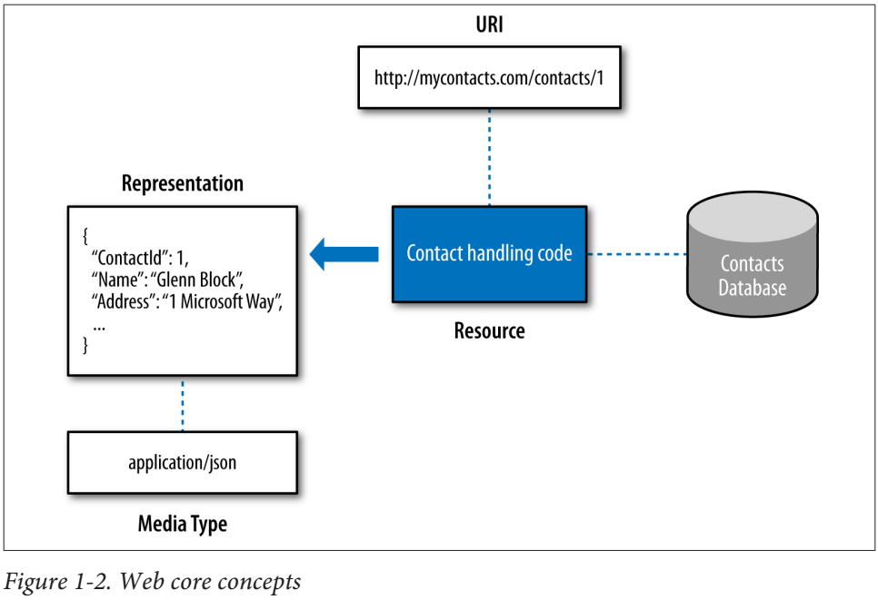
Figure 1-2

Slide 10
Resource
A resource is anything that has a URI.
The resource itself is a conceptual mapping to one or more entities.
In the early years of the Web it was very common for this entity to be a file such as a document or web page.
However, a resource is not limited to being file oriented.
A resource can be a service that interfaces with anything such as a catalog, a device (e.g., a printer), a wireless garage door opener, or an internal system like a CRM or a procurement system.
A resource can also be a streaming medium such as a video or an audio stream.

Slide 11
Is a Resource Bound to an Entity | Database?
A common misnomer today with Web APIs is that each resource must map to an entity or business object backed by a database.
Often, this will come up in a design conversation where someone might say, “We can’t have that resource because it will require us to create a table in the database and we have no real need for a table.”
The previous definition described a mapping to one or more entities; this is an entity in the general sense of the word (i.e., it could be anything), not a business object.
An application may be designed such that the resources exposed always map to business entities or tables, and in such a system the previous statement would be true.
However, that is a constraint imposed by an application or framework, not the Web.
When you are building Web APIs, there are many cases where the entity/resource constraint is problematic.
For example, an order processing resource actually orchestrates different systems to process an order.
In this case, the resource implementation invokes various parts of the system that may themselves store state in a database.
It may even store some of its own state, or not.

Slide 12
Is a Resource Bound to an Entity | Database? |
The point is there is not a direct database correspondence for that resource.
Also, there is no requirement that the orchestrated components use a database either (though in this case they do).
Keep this distinction in mind as you go forward in your Web API design.
It will help you to really harness the power of the Web within you systems.

Slide 13
URI

Slide 14
Cool URIs

Slide 15
Representation

Slide 16
Media Type

Slide 17
HTTP
Now that we have covered the high-level web architecture, our next stop is HTTP.
As HTTP is very comprehensive, we will not attempt to cover everything.
Rather, we will focus on the major concepts—in particular, those that relate to building Web APIs.
If you are new to HTTP, it should give you a good lay of the land.
If you are not, you might pick up some things you didn’t know, but it’s also OK to skip it.
HTTP is the application-level protocol for information systems that powers the Web.
HTTP was originally authored by three computer scientists: Tim Berners-Lee, Roy Fielding, and Henrik Frystyk Nielsen.
It defines a uniform interface for clients and servers to transfer information across a network in a manner that is agnostic to implementation details.
HTTP is designed for dynamically changing systems that can tolerate some degree of latency and some degree of staleness.
This design allows intermediaries like proxy servers to intercede in communication, providing various benefits like
Caching Compression Routing

Slide 18
HTTP |
These qualities of HTTP make it ideal for the World Wide Web, as it is a massive and dynamically changing and evolving network topology with inherent latency.
It has also stood the test of time, powering the World Wide Web since its introduction in 1996.

Slide 19
Moving Beyond HTTP 1.1
HTTP is not standing still: it is actively evolving both in
how we understand it
how we use it
There have been many misconceptions around the HTTP spec RFC 2616 due to ambiguities, or in some cases due to things deemed incorrect.
The IETF (Internet Engineering Task Force) formed a working body known as httpbis that has created a set of drafts whose sole purpose is to clarify these misconceptions by completely replacing RFC 2616.
Additionally, the group has been charged with creating the HTTP 2.0 spec.
HTTP 2.0 also does not affect any of the public HTTP surface area; rather, it is a set of optimizations to the underlying transport, including adoption of the new SPDY protocol.
Because httpbis exists as a replacement for the HTTP spec and provides an evolved understanding of HTTP, we’ll use that as the basis for the remainder of this section.

Slide 20
HTTP Message Exchange
HTTP-based systems exchange messages in a stateless manner using a request/response pattern.
We’ll give you a simplified overview of the exchange.
First, an HTTP client generates an HTTP request, as shown in Figure 1-4.
That request is a message that includes
an HTTP version
a URI of a resource that will be accessed
request headers
an HTTP method (like GET)
an optional entity body (content)
The request is then sent to an origin server where the resource presides.
The server looks at the URI and HTTP method to decide if it can handle the message.
If it can, it looks at the request headers that contain control information such as describing the content.
The server then processes the message based on that information.

Slide 21
HTTP Message Exchange |
After the server has processed the message, an HTTP response, generally containing a representation of the resource (as shown in Figure 1-5), is generated.
The response contains
the HTTP version
response headers
an optional entity body (containing the representation)
a status code
a description
Similar to the server that received the message, the client will inspect the response headers using its control information to process the message and its content.

Slide 22
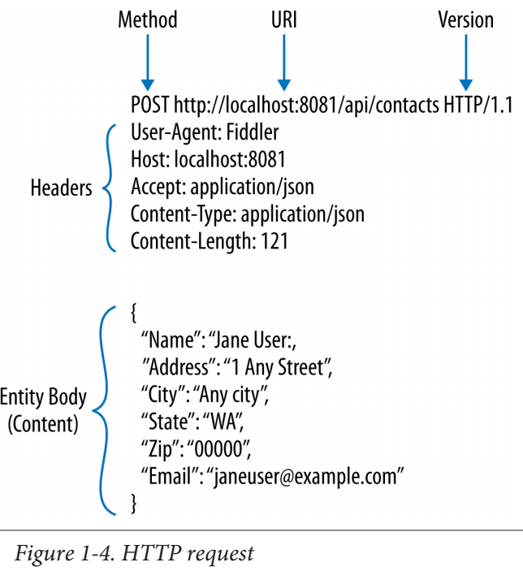
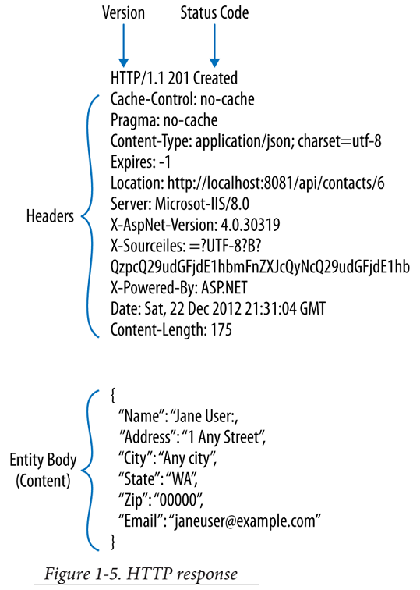
Figure 1-4 || 1-5

Slide 23
Intermediaries
Though accurate, the preceding description of HTTP message exchange leaves out an important piece: intermediaries).
HTTP is a layered architecture in which each component/server has SoC from others in the system; it is not required for an HTTP client to “see” the origin server.
As the request travels along toward the origin server, it will encounter intermediaries, as shown in Figure 1-6, which are agents or components that inspect an HTTP request or response and may modify or replace it.
An intermediary can
immediately return a response
invoke some sort of process like logging the details or
just let it flow through
Intermediaries are beneficial in that they can improve or enhance communication.
For example, a cache can reduce the response time by returning a cached result received from an origin server.

Slide 24
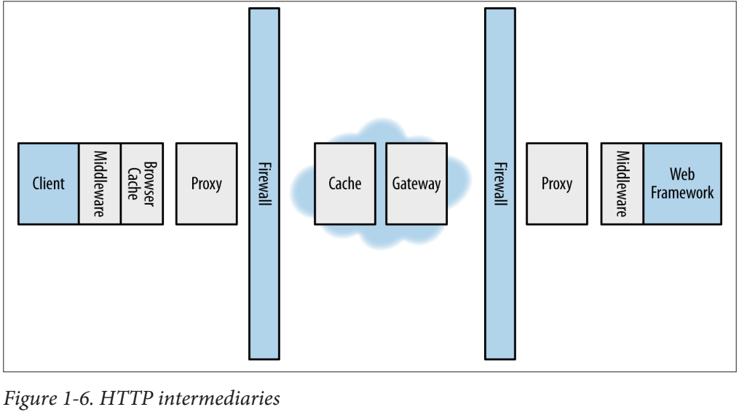
Figure 1-6

Slide 25
Intermediaries Location
Notice that intermediaries can exist anywhere the request travels between the client and origin server; location does not matter.
They can be running on the same machine as the client or origin server or be a dedicated public server on the Internet.
They can be built in, such as the browser cache on Windows, or add-ons commonly known as middleware.
ASP.NET Web API supports several pieces of middleware that can be used on the client or server, such as handlers and filters, which you will learn about in Chapters 4 and 10.

Slide 26
Types of Intermediaries
There are three types of intermediaries that participate in the HTTP message exchange and are visible to clients.
A proxy is an agent that handles making HTTP requests and receiving responses on behalf of the client.
The client’s use of the proxy is deliberate, and it will be configured to use it.
It is common, for example, for many organizations to have an internal proxy that users must go through in order to make requests to the Internet.
A proxy that modifies requests or responses in a meaningful way is known as a transforming proxy.
A proxy that does not modify messages is known as a non‐ transforming proxy.
A gateway receives inbound HTTP messages and translates them to the server’s underlying protocol, which may or may not be HTTP.
The gateway also takes out‐ bound messages and translates them to HTTP. A gateway can act on behalf of the origin server.
A tunnel creates a private channel between two connections without modifying any of the messages.
An example of a tunnel is when two clients communicate via HTTPS through a firewall.

Slide 27
Is a CDN an Intermediary?
Another common mechanism for caching on the Internet is a content delivery network (CDN), a distributed set of machines that cache and return static content.
There are many popular CDN offerings, such as Akamai, that companies use to cache their content.
So is a CDN an intermediary? The answer is that it depends on how the request is passing to the CDN.
If the client makes a direct request to it, then it is acting as an origin server.
Some CDNs, however, can also act as a gateway, where the client does not see the CDN, but it actually acts on behalf of the origin server as a cache and returns the content.

Slide 28
HTTP Methods

Slide 29
Headers

Slide 36
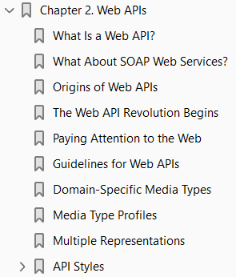
2
Web APIs

Slide 37
Intro
In the preceding chapter, we learned about the essential aspects of the Web and HTTP, the application layer protocol that drives it.
In this chapter, we’ll talk about the evolution of Web APIs, cover various Web API–related concepts, and discuss different styles and approaches for designing Web APIs.

Slide 38
What Is a Web API?
A Web API is a programmatic interface to a system that is accessed via standard HTTP methods and headers.
A Web API can be accessed by a variety of HTTP clients, including
Browsers
mobile devices
Web APIs can also benefit from the web infrastructure for concerns like
Caching
Concurrency

Slide 39
What About SOAP Web Services?
SOAP services are not web-friendly.
They are not easily consumable from HTTP clients, such as browsers or tools like curl.
A SOAP request has to be properly encoded in a SOAP message format.
The client has to have access to a Web Service Description Language (WSDL) file, which describes the actions available on the service, and also has to know how to construct the message.
This means the semantics of how to interact with the system are tunneled over HTTP rather than being first class.
Additionally, SOAP web services generally require all interactions to be via HTTP POST; thus, the responses are also non-cacheable.
Finally, SOAP services do not allow one to access HTTP headers, which severely limits clients from benefitting from features of HTTP like
optimistic concurrency
content negotiation

Slide 40
Origins of Web APIs
In February 2000, Salesforce.com launched a new API that allowed customers to harness Salesforce capabilities directly within their applications.
Later that same year in November, eBay launched a new API that allowed developers to build ecommerce applications leveraging eBay’s infrastructure.
What differentiated these APIs from SOAP APIs (the other emerging trend)?
These Web APIs were targeting third-party consumers and designed in an HTTP-friendly way.
The traditional APIs of the time had been mostly designed for system integration and were SOAP-based.
These APIs utilized plain old XML as the message exchange format and plain old HTTP as the protocol.
This allowed them to be used from a very broad set of clients, including simple web browsers.
These were the first of many such Web APIs to come.
For the next few years after Salesforce and eBay took these first steps, similar APIs started to appear on the scene.
In 2002, Amazon officially introduced Amazon Web Services, followed by Flickr launching its Flickr API in 2004.

Slide 41
The Web API Revolution Begins
In the summer of 2005, ProgrammableWeb.com launched.
Its goal was to be a one-stop shop for everything API related.
It included a directory of public APIs (both SOAP and non-SOAP) containing 32 APIs, which was considerable growth from 2002.
Over the next few years, however, that number would explode.
APIs would run the gamut from major players such as
Facebook
Twitter
Google
LinkedIn
Microsoft
Amazon
to then-small startups like
YouTube
Foursquare

Slide 42
The Web API Revolution Begins |
In November 2008, Programmable‐ Web’s directory was tracking 1,000 APIs.
Four years later, at the time of this writing, that number exceeds 7,000.
API growth is accelerating, as just about a year ago the number was 4,000.
In other words, it is clear that Web APIs are here to stay.

Slide 43
Paying Attention to the Web
The earliest Web APIs weren’t necessarily concerned with the underlying web architecture and its design constraints.
This had ramifications such as the infamous Google Web Accelerator incident, which resulted in a loss of customer data and content.
In recent years, however, with an exponential rise in third-party API consumers and in devices, this has changed.
Organizations are finding they can no longer afford to ignore the web architecture in their API design, because doing so has negatively impacted their ability to scale, to support a growing set of clients, and to evolve their APIs without breaking existing consumers.
The remainder of this chapter is a primer on web architecture and HTTP as they relate to building Web APIs.
It will give you a foundation that will allow you to leverage the power of the Web as you begin to develop your own Web APIs using ASP.NET Web API.

Slide 44
Guidelines for Web APIs
This section lists some guidelines for differentiating Web APIs from other forms of APIs.
In general, a key differentiator for Web APIs is that they are browser-friendly.
In addition, Web APIs:
Can be accessed from a range of clients (including browsers at minimum).
Support standard HTTP methods such as those mentioned in Table 1-1.
It is not required for an API to use all of the methods, but at minimum it should support GET for retrieval of resources and POST for unsafe operations.
Support browser-friendly formats. This means that they support formats that are easy for browsers and any other HTTP client to consume.
A browser client can technically consume a SOAP message using its XML stack, but the format requires a large amount of SOAP-specific code to do it.
Formats like XHTML, JSON, and Form URL encoding are very easy to consume in a browser.
Support browser-friendly authentication.
This means that a browser client can authenticate with the server without requiring any special plugins or extensions.

Slide 45
Domain-Specific Media Types

Slide 46
Media Type Profiles

Slide 47
Multiple Representations

Slide 48
API Styles
There are many different architectural styles for building Web APIs.
By style we mean an approach for implementing an API over HTTP.
A style is a set of common characteristics and constraints that permeate the design.
Each style has trade-offs and benefits associated with it.
The important thing to recognize is that the style is an application of HTTP; it is not HTTP.
For example, Gothic is a style applied to architecture.
You can look at various buildings and determine which are Gothic because they possess certain qualities, such as ogival arches, ribbed vaults, and flying buttresses.
In the same way, API styles share a set of qualities that manifest in different APIs.
Today we see a number of styles, but they land in a spectrum with RPC on one side and REST on the other.

Slide 49
The Richardson Maturity Model
The Richardson Maturity Model (RMM) by Leonard Richardson introduces a framework for classifying APIs into different levels based on how well they take advantage of web technologies.
Level 0, RPC oriented: A single URI and one HTTP method.
Level 1, Resource oriented: Many URIs, one HTTP method.
Level 2, HTTP verbs: Many URIs, each supporting multiple HTTP methods.
Level 3, Hypermedia: Resources describe their own capabilities and interactions.
The model was designed to classify the existing APIs of the time. It became wildly popular and is used by many folks in the API community for classifying their APIs today.
It was not without issue, though.
The model was not created to establish a rating scale to evaluate how RESTful an API is.
Unfortunately, many took it for just that and began to use it as a stick to beat others for not being RESTful enough.
This appears to be one of the reasons why Leonard Richardson himself has stopped promoting it.
Throughout this chapter, you’ll dive more deeply into the different levels of RMM and see real-world examples.
We’ll use the levels to discuss the benefits and trade-offs associated with how you design your API.

Slide 50
RPC (RMM Level 0)

Slide 51
Resources (RMM Level 1)

Slide 52
HTTP VERBS (RMM Level 2)

Slide 53
Crossing the Chasm Toward Resource-Centric APIs

Slide 54
Hypermedia (RMM Level 3)

Slide 55
REST

Slide 56
REST Constraints

Slide 57
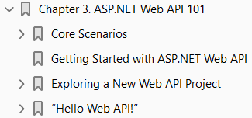
3
ASP.NET Web API 101

Slide 58
Intro

Slide 59
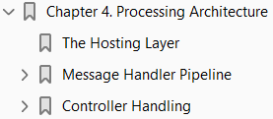
4
Processing Architecture

Slide 60
Intro

Slide 61
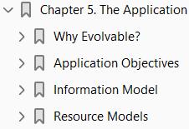
5
The Application

Slide 62
Intro

Slide 63
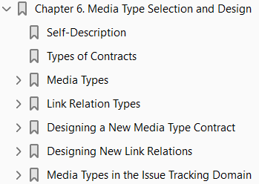
6

Slide 64
Intro

Slide 65
7

Slide 66
Intro

Slide 67
8

Slide 68
Intro

Slide 69
9

Slide 70
Intro

Slide 71
11

Slide 72
Intro

